Slide 1


0
10
9
8
7
6
5
4
3
2
1

Slide 2

Robotics Corner

Slide 3
Localization

Slide 4
01
What is localization
02
Dead reckoning
AGENDA
03
AMCL
04
Localizing a robot
05
Simulation

Slide 5


Localization in ROS
AMCL
01285960031
01285960031
www.roboticscorner.tech

Slide 6
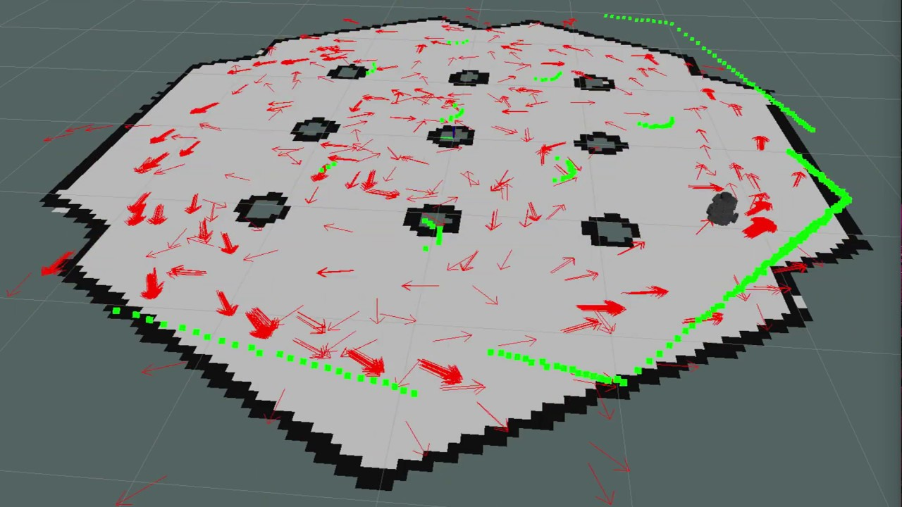
01
What is localization
Definition
Robot localization is the process of determining where a mobile robot is located with respect to its environment.
01285960031
01285960031
www.roboticscorner.tech

Slide 7
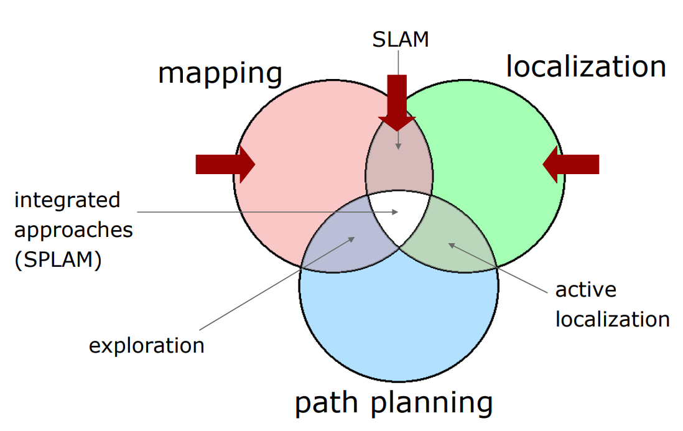
Localization
01
What is localization
01285960031
01285960031
www.roboticscorner.tech

Slide 8
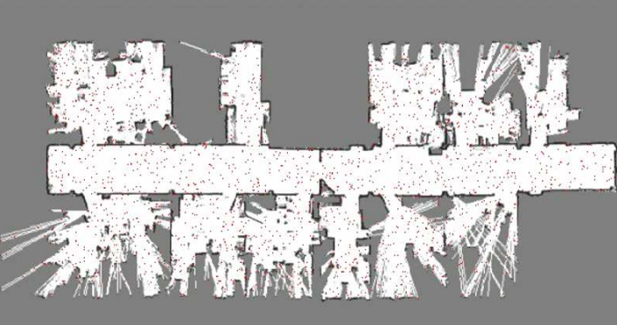
Localization
01
What is localization
Determine the current robot position, the measurements up to the current instant and a map.
01285960031
01285960031
www.roboticscorner.tech

Slide 9

Dead Reckoning
02
Dead Reckoning
01285960031
01285960031
www.roboticscorner.tech

Slide 10
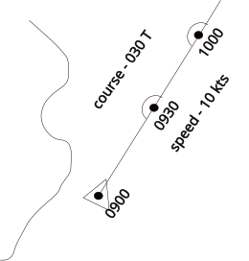
Dead Reckoning
02
Dead Reckoning
The process of calculating the current position of a moving object by using a previously determined position, or fix, and incorporating estimates of speed, heading (or direction or course), and elapsed time. The corresponding term in biology, to describe the processes by which animals update their estimates of position or heading, is path integration.
01285960031
01285960031
www.roboticscorner.tech

Slide 11
AMCL (Adaptive Monte Carlo Localization)
03
AMCL
amcl is a probabilistic localization system for a robot moving in 2D. It implements the adaptive (or KLD-sampling) Monte Carlo localization approach (as described by Dieter Fox), which uses a particle filter to track the pose of a robot against a known map.
01285960031
01285960031
www.roboticscorner.tech

Slide 12
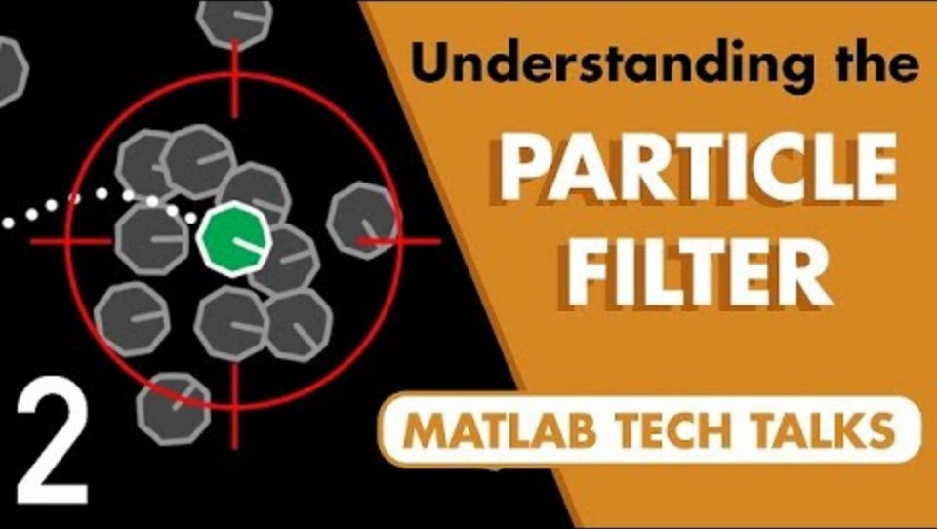
AMCL Localization
01
AMCL
01285960031
01285960031
www.roboticscorner.tech

Slide 13
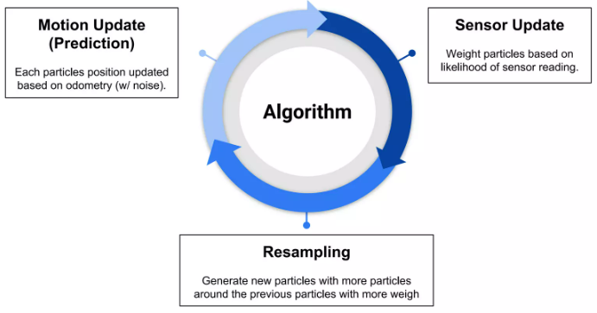
AMCL
03
AMCL
01285960031
01285960031
www.roboticscorner.tech

Slide 14
Localizing a Robot
04
Localizing a Robot
ROS implements the Adaptive Monte Carlo Localization algorithm
AMCL uses a particle filter to track the position of the robot
Each pose is represented by a particle.
Particles are
Moved according to (relative) movement measured by the odometry
Suppressed/replicated based on how well the laser scan fits the map, given the position of the particle.
The localization is integrated in ROS by emitting a transform from a map-frame to the odom frame that “corrects” the odometry.
To query the robot position according to the localization you should ask the transform of base_footprint in the map frame.
01285960031
01285960031
www.roboticscorner.tech

Slide 15
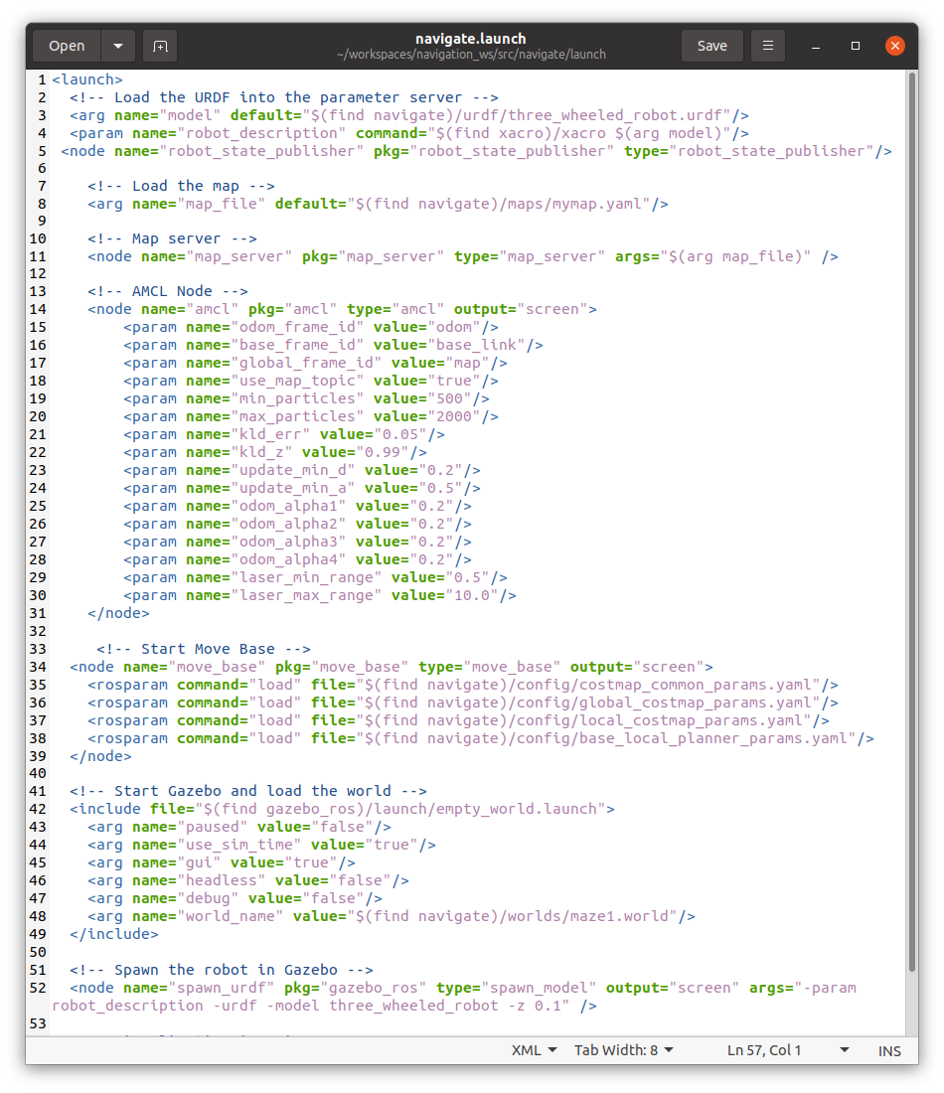
Launch file
04
Simulation
You can make a launch file to launch localization node (amcl) with the preferred configurations.
We can also launch the move_base node which we will learn about later on.
And don’t forget to launch rviz.
01285960031
01285960031
www.roboticscorner.tech

Slide 16
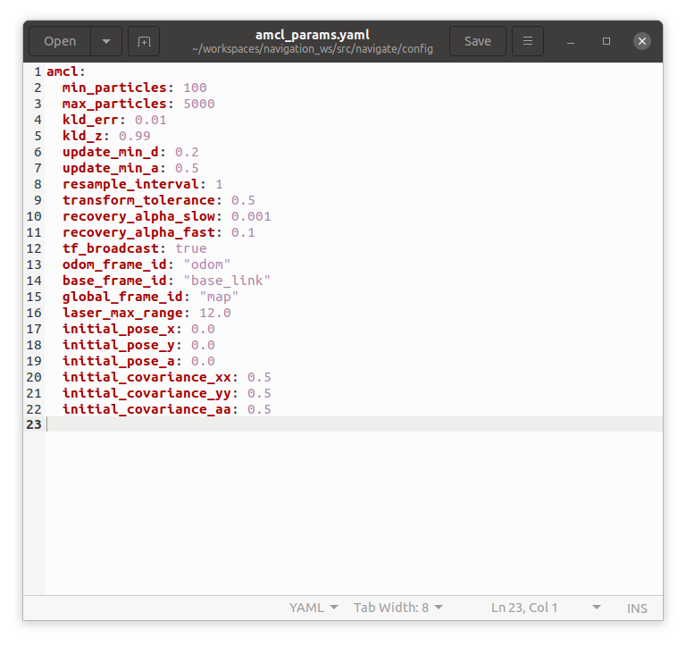
Config file for amcl
04
Simulation
You can also use a Yaml file for amcl configuration and include it in the amcl node in the launch file
You can include it in the node by writing:
<rosparam file="$(find my_robot_name_2dnav)/amcl_params.yaml" command="load" />
01285960031
01285960031
www.roboticscorner.tech

Slide 17
RVIZ configuration
04
Simulation
Keep in mind that in order for the particle filter and map to appear in rviz you should add the topics alongside with the scan.
Add “poseArray” to rviz and make sure that the topic you subscribe to is the particle cloud “/particlecloud”
Add “laserScan” to rviz and make sure that the topic you subscribe to is the laser topic “/scan” for example
Add “map” to rviz and make sure that the topic you subscribe to is the map topic “/map”
01285960031
01285960031
www.roboticscorner.tech

Slide 18
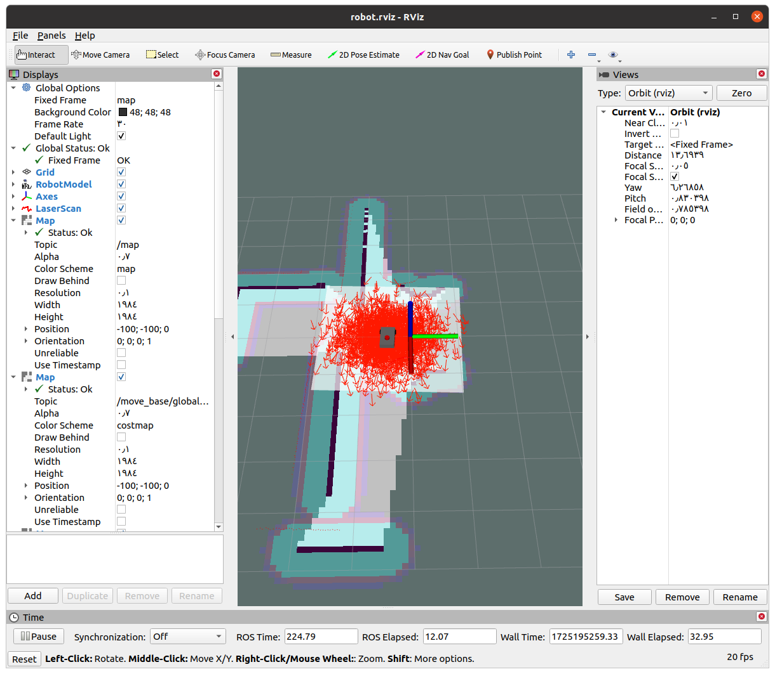
05
Simulation
01285960031
01285960031
www.roboticscorner.tech

Slide 19
05
Simulation
The amcl package starts to spread its particles to try to localize the robot.
When you move the robot, it starts to eliminate some points, and the particles become concentrated in one spot.
If you know the correct position you can localize the robot manually according to the map by choosing “2D Pose Estimate” from rviz and choosing the right location.
01285960031
01285960031
www.roboticscorner.tech

Slide 20
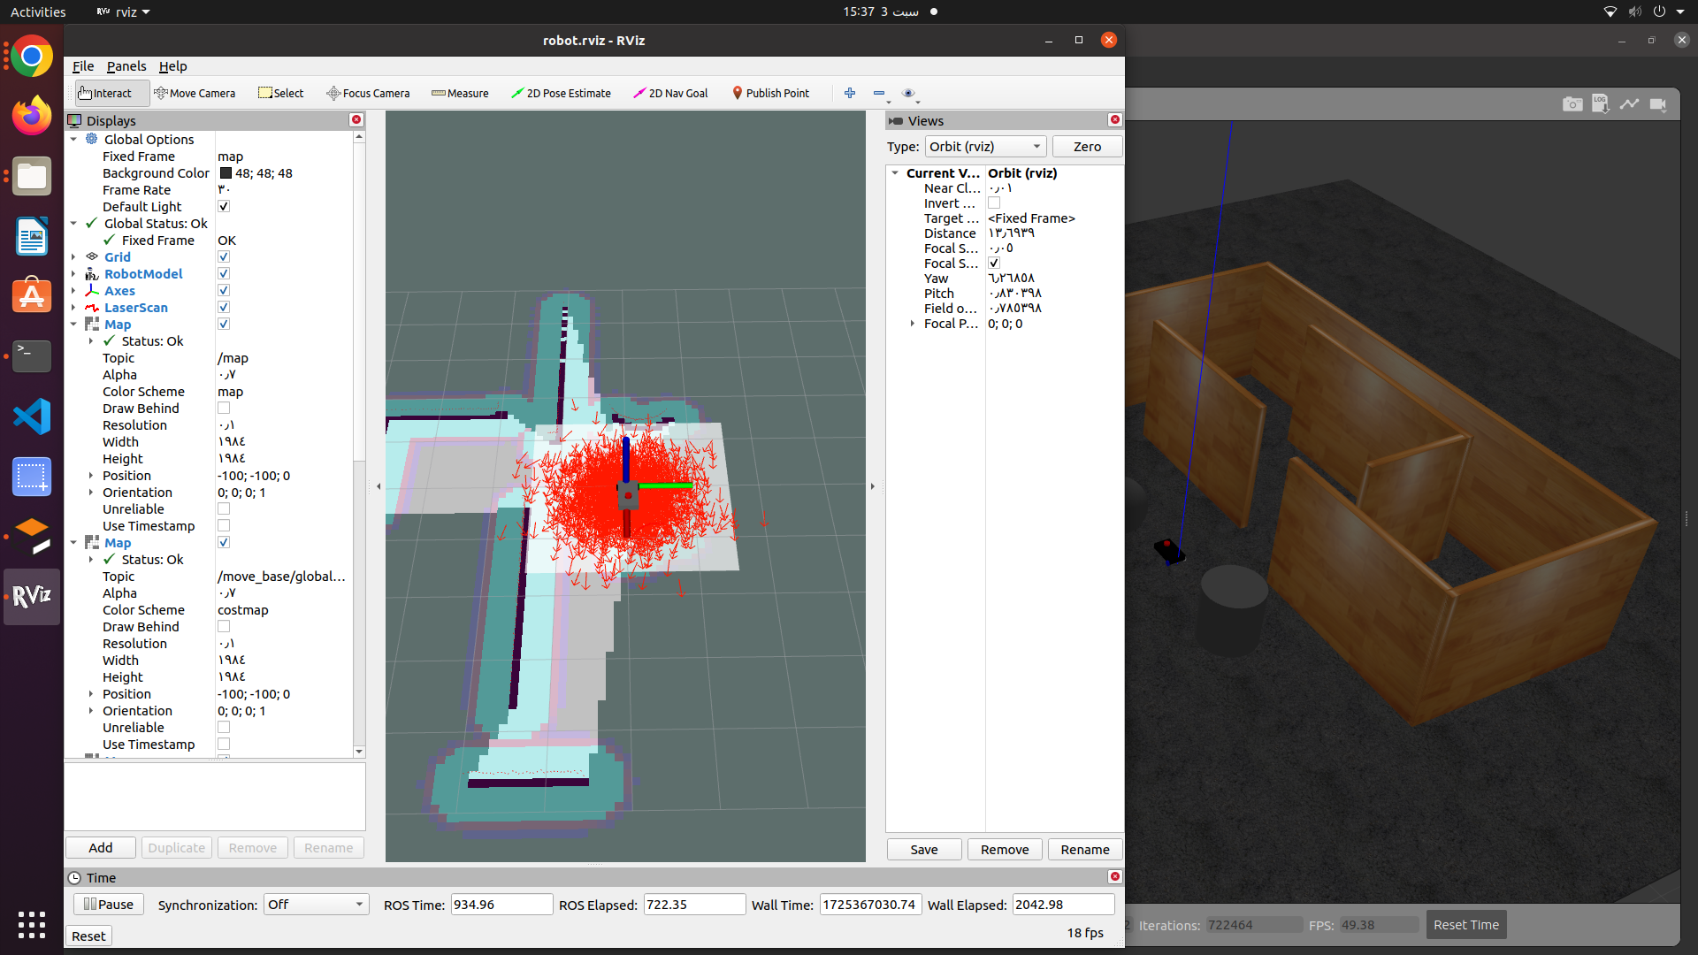
05
Simulation
01285960031
01285960031
www.roboticscorner.tech

Slide 21
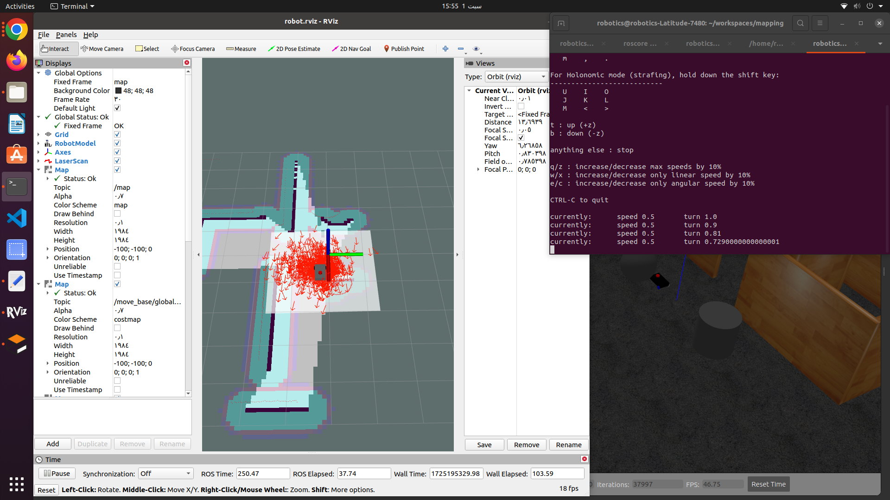
05
Simulation
01285960031
01285960031
www.roboticscorner.tech

Slide 22
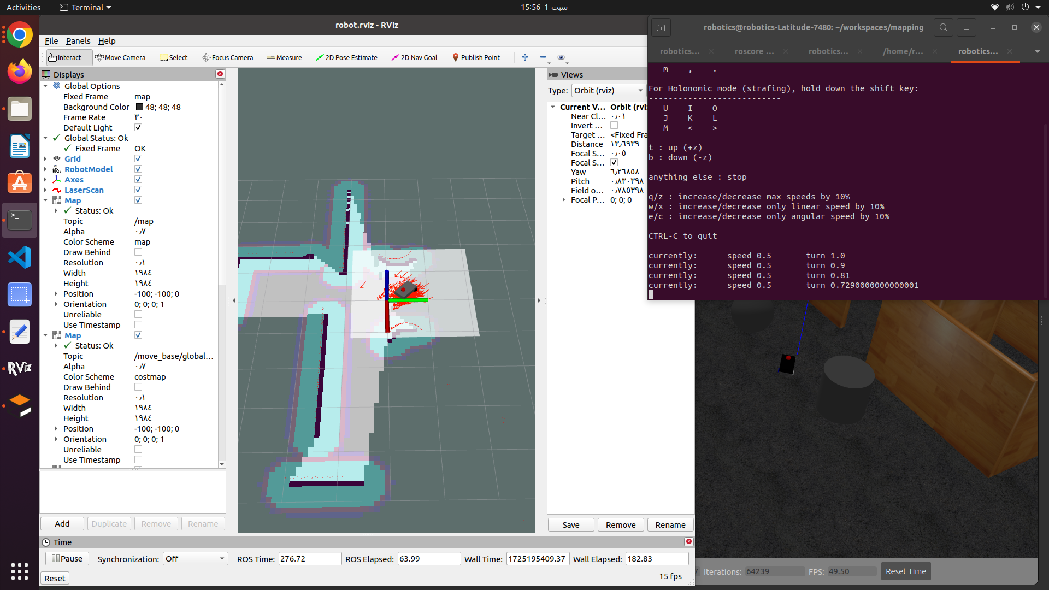
05
Simulation
01285960031
01285960031
www.roboticscorner.tech

Slide 23



Slide 24

01211626904
www.roboticscorner.tech
Robotics Corner
Robotics Corner
Robotics Corner
Robotics Corner

